Slide 1
Unit 8. Multiple Antennas and Beamforming
EL-GY 6023. Wireless Communications
Prof. Sundeep rangan

Slide 2
Outline
Antenna Arrays and the Spatial Signature
Receive Beamforming and SNR Gain with a Single Path
Array Factor
Transmit Beamforming with a Single Path
Multipath and MIMO Channels
Linear Algebra and SVD Review
Beamforming Gains in Multipath Channels
Adding Element Gains and Normalizing Spatial Signatures for Mutual Coupling

Slide 3
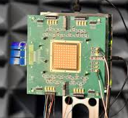
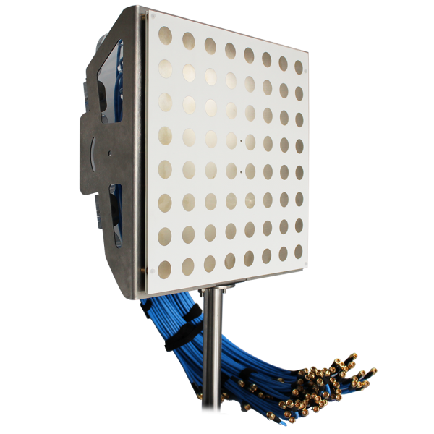
Antenna Arrays
Antenna arrays: Structure with multiple antennas
At TX and/or RX
Key to 5G mmWave and massive MIMO
Two key benefits
Beamforming: This lecture
Concentrate power in particular directions
Increases SNR and may enable spatial diversity
Requires arrays at either TX or RX
Spatial multiplexing: Later
Enables transmission in multiple virtual paths
Increases degrees of freedom
Requires multiple antennas at both TX and RX
IBM 28 GHz array
32 element dual polarized array Sadhu et al, ISSCC 2017
Aurora C-Band Massive MIMO array
64 elements, 5-6 GHz
https://www.taoglas.com/

Slide 4
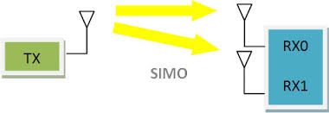
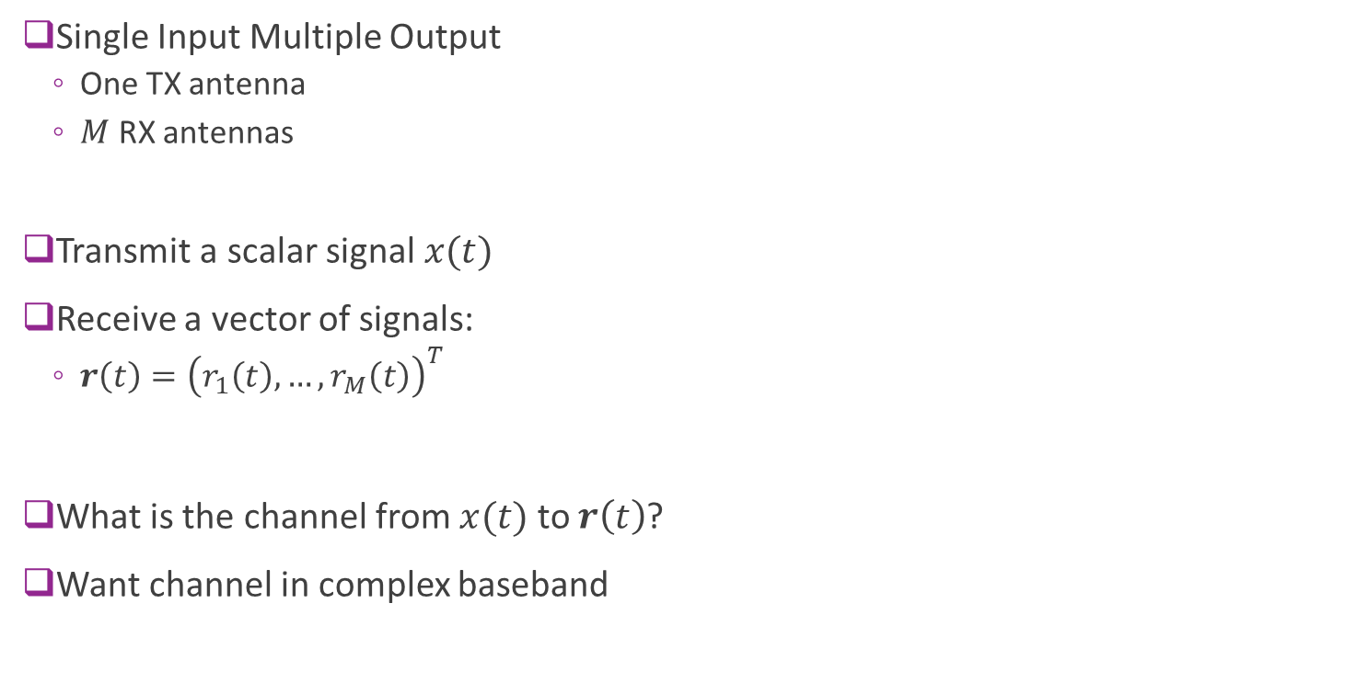
Multiple Receive Antennas
Single Input Multiple Output
One TX antenna
$M$ RX antennas
Transmit a scalar signal $x(t)$
Receive a vector of signals:
$r\left(t\right)={\left(r_{1}\left(t\right),…,r_{M}\left(t\right)\right)}^{T}$
What is the channel from $x(t)$ to $r\left(t\right)$?
Want channel in complex baseband

Slide 5

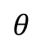
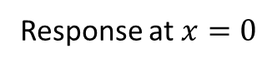
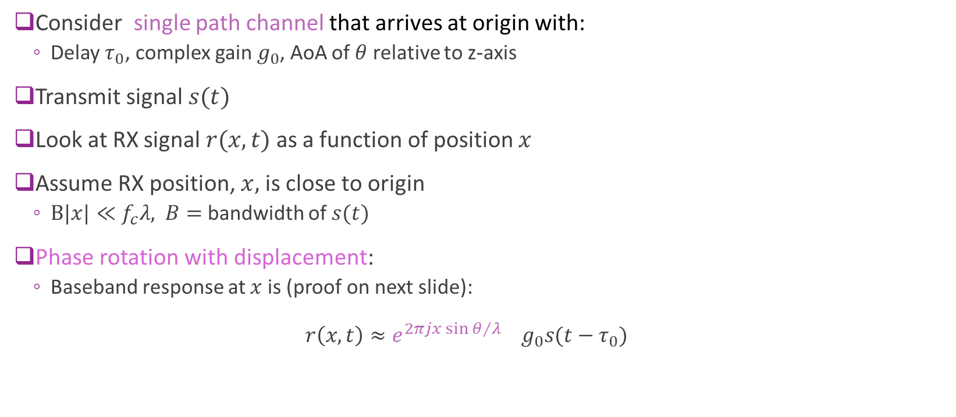
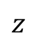
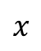
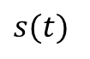
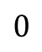
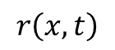
Channel vs. Position
$$z$$
$s(t)$
Consider single path channel that arrives at origin with:
Delay $τ_{0}$, complex gain $g_{0}$, AoA of $θ$ relative to z-axis
Transmit signal $s(t)$
Look at RX signal $r(x,t)$ as a function of position $x$
Assume RX position, $x,$ is close to origin
$B|x|≪f_{c}λ,$ $B=$ bandwidth of $s(t)$
Phase rotation with displacement:
Baseband response at $x$is (proof on next slide): $r\left(x,t\right)≈e^{2πj{x\sin{θ}}/λ} g_{0}s(t−τ_{0})$
$$θ$$
RX position
$$0$$
$$x$$
$$r\left(x,t\right)$$
Phase rotation with $x$
Response at $x=0$

Slide 6
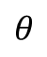
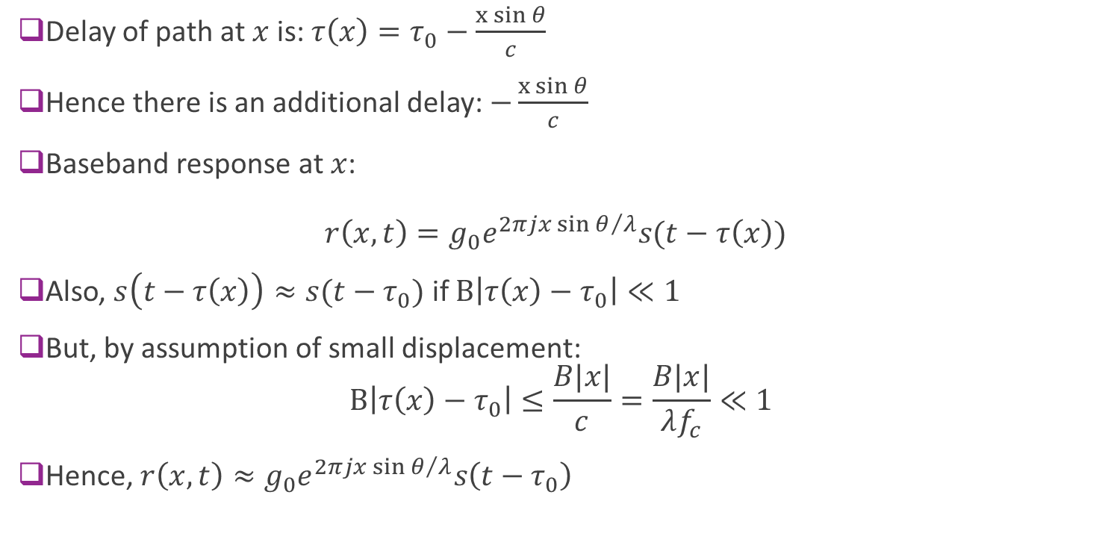
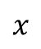
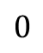
Proof of Phase Rotation with Displacement
Delay of path at $x$ is: $τ\left(x\right)=τ_{0}−\frac{x{\sin{θ}}}{c}$
Hence there is an additional delay: $−\frac{x{\sin{θ}}}{c}$
Baseband response at $x$: $r\left(x,t\right)=g_{0}e^{2πj{x\sin{θ}}/λ}s(t−τ\left(x\right))$
Also, $s\left(t−τ\left(x\right)\right)≈s(t−τ_{0})$ if $B\left|τ\left(x\right)−τ_{0}\right|≪1$
But, by assumption of small displacement: $B\left|τ\left(x\right)−τ_{0}\right|≤\frac{B|x|}{c}=\frac{B|x|}{λf_{c}}≪1$
Hence, $r\left(x,t\right)≈g_{0}e^{2πj{x\sin{θ}}/λ}s\left(t−τ_{0}\right)$
$$θ$$
$$0$$
$$x$$
RX position

Slide 7
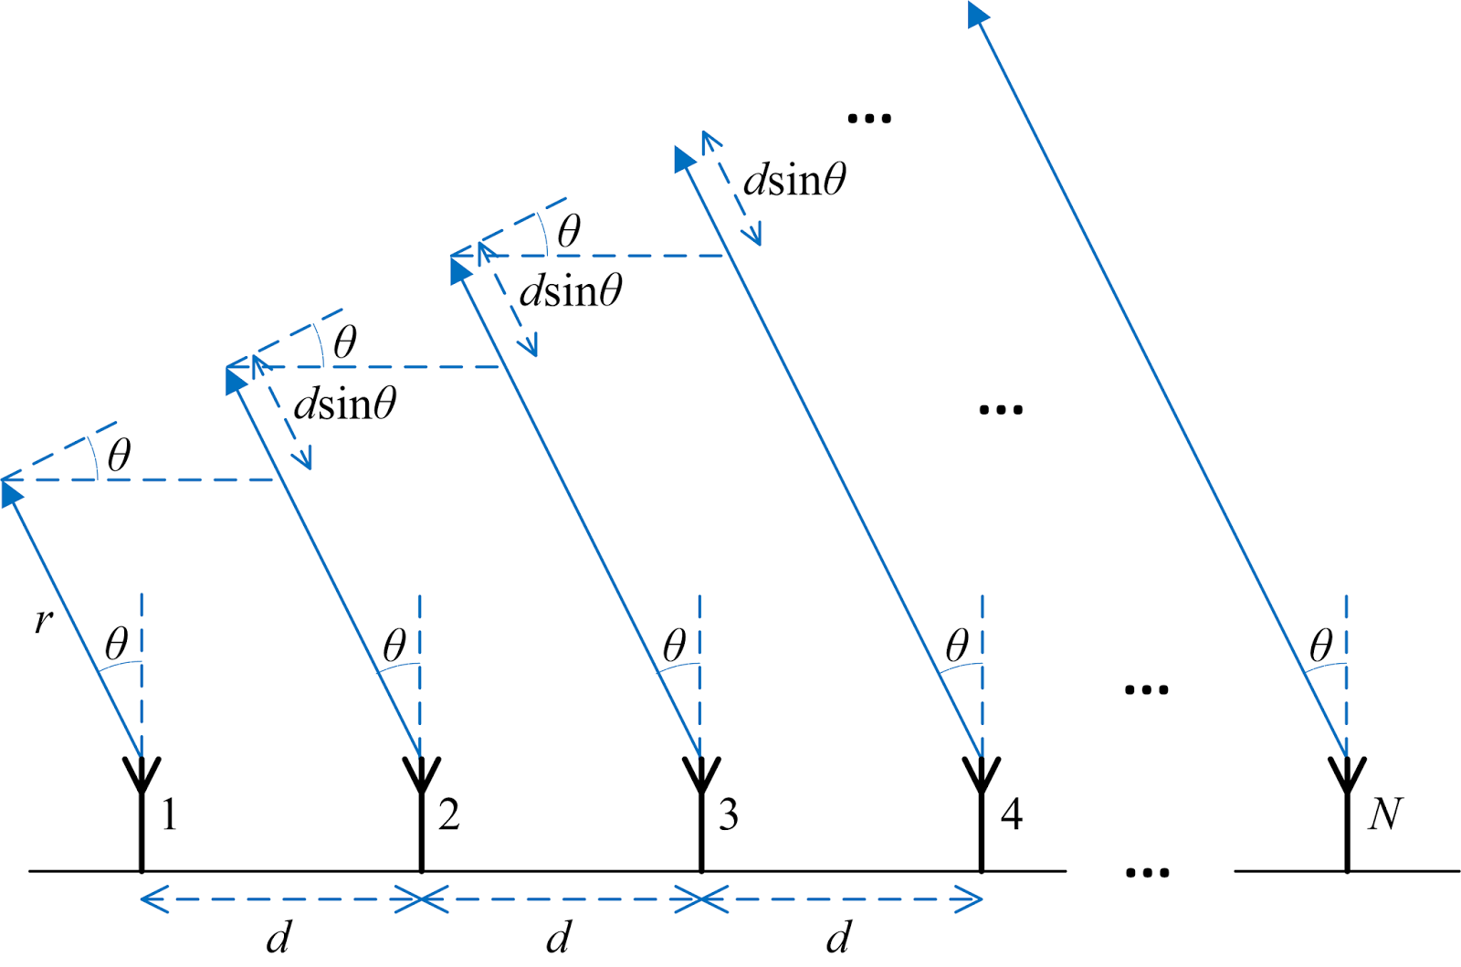
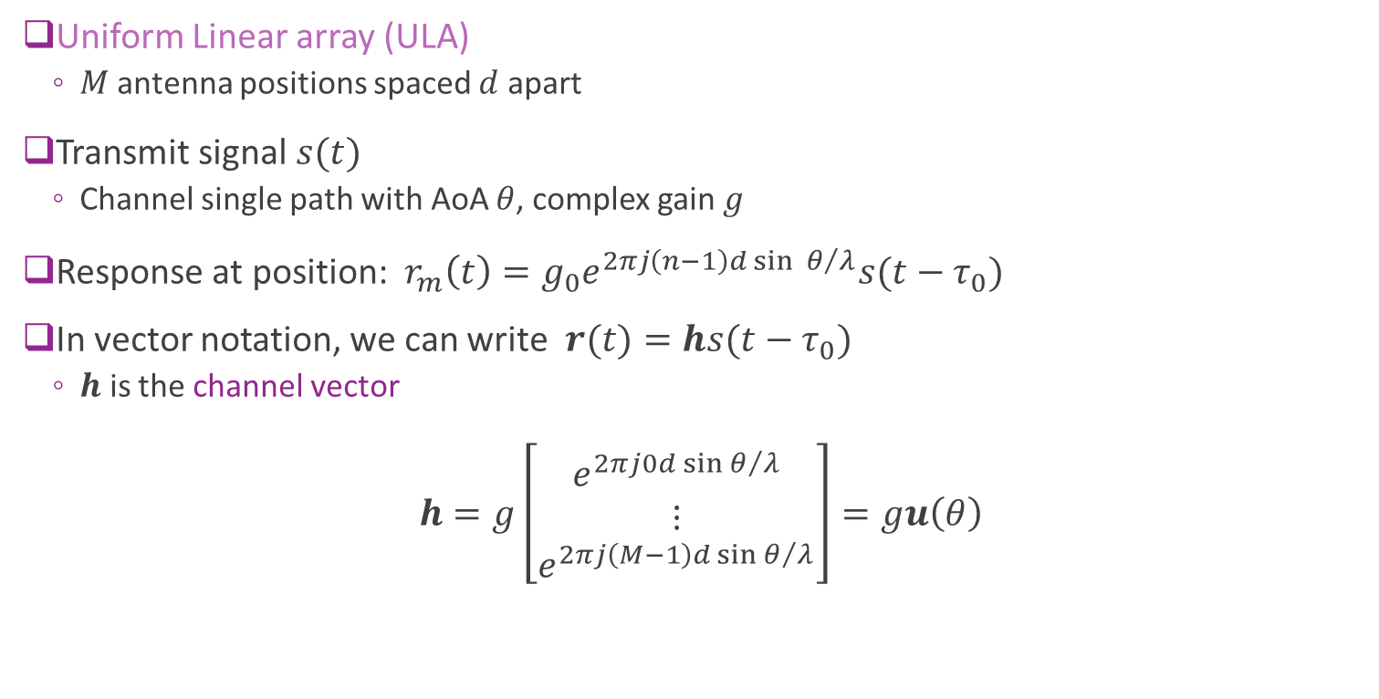
Response for a ULA
Uniform Linear array (ULA)
$M$antenna positions spaced $d$ apart
Transmit signal $s(t)$
Channel single path with AoA $θ$, complex gain $g$
Response at position: $r_{m}\left(t\right)=g_{0}e^{2πj{\left(n−1\right)d\sin{θ}}/λ}s(t−τ_{0})$
In vector notation, we can write $r(t)=hs(t−τ_{0})$
$h$ is the channel vector
$$h=g\left[\begin{matrix}e^{2πj{0d\sin{θ}}/λ} \\ ⋮ \\ e^{2πj{\left(M−1\right)d\sin{θ}}/λ}\end{matrix}\right]=gu\left(θ\right)$$

Slide 8
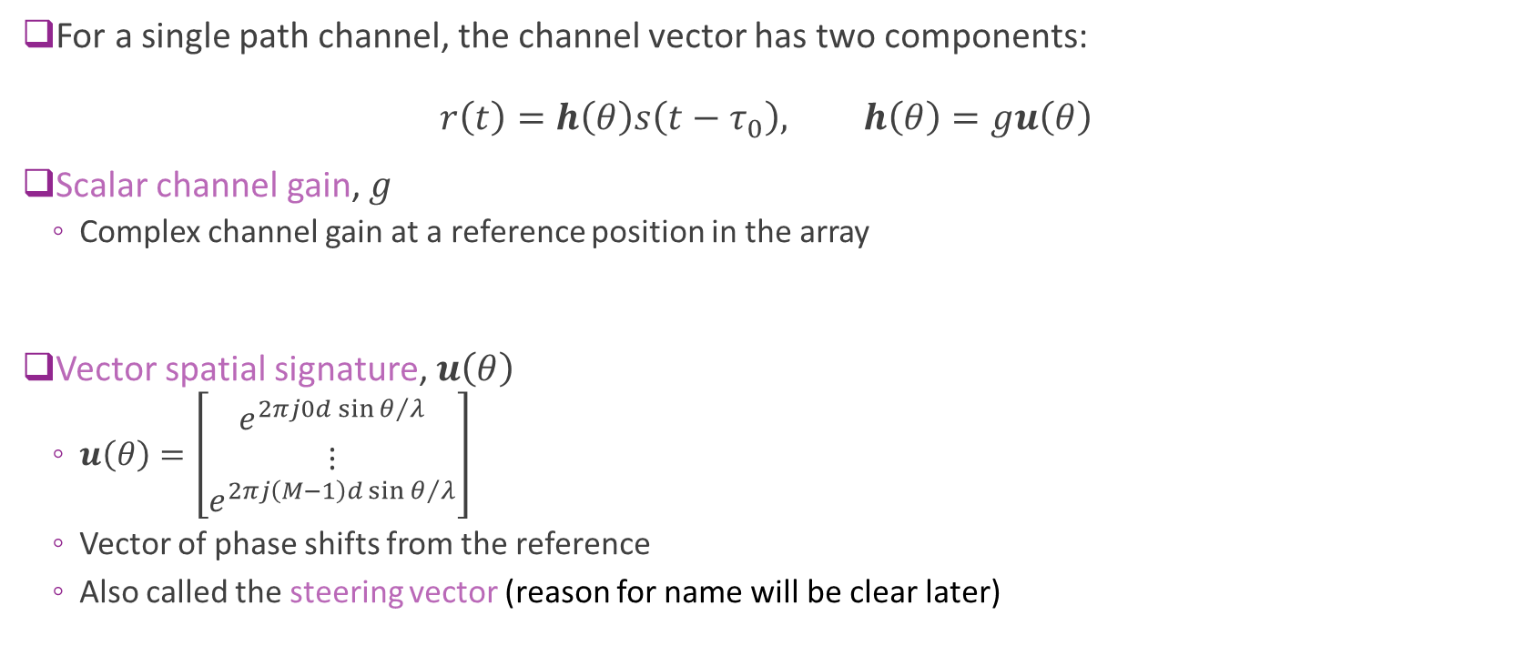
Response Decomposition
For a single path channel, the channel vector has two components: $r\left(t\right)=h\left(θ\right)s\left(t−τ_{0}\right), h\left(θ\right)=gu\left(θ\right)$
Scalar channel gain, $g$
Complex channel gain at a reference position in the array
Vector spatial signature, $u\left(θ\right)$
$u\left(θ\right)=\left[\begin{matrix}e^{2πj{0d\sin{θ}}/λ} \\ ⋮ \\ e^{2πj{\left(M−1\right)d\sin{θ}}/λ}\end{matrix}\right]$
Vector of phase shifts from the reference
Also called the steering vector (reason for name will be clear later)

Slide 9
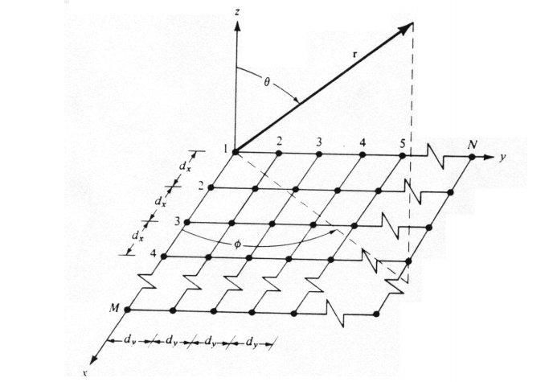
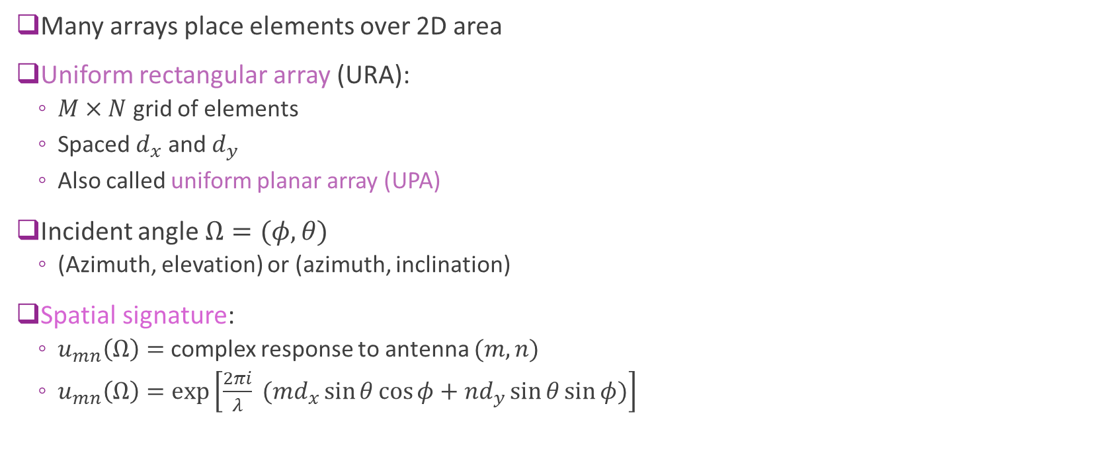
Array Response in 3D
Many arrays place elements over 2D area
Uniform rectangular array (URA):
$M×N$ grid of elements
Spaced $d_{x}$ and $d_{y}$
Also called uniform planar array (UPA)
Incident angle $Ω=(φ, θ)$
(Azimuth, elevation) or (azimuth, inclination)
Spatial signature:
$u_{mn}\left(Ω\right)=$ complex response to antenna $(m,n)$
$u_{mn}\left(Ω\right)=\exp\left[\frac{2πi}{λ} (md_{x}\sin{θ}\cos{φ}+nd_{y}\sin{θ}\sin{φ})\right]$

Slide 10
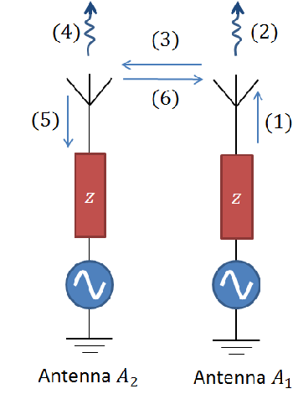
Mutual Coupling
The above formulas assume there is no mutual coupling
Mutual coupling:
Signals on one antenna scatter to another antenna
Changes the antenna response
Mutual coupling effect is typically large when:
Antennas are close
Or arrays are combined with highly directive elements
We will show how to account for mutual coupling at the end of unit
Wang, Zhengzheng. “Complete tool for predicting the mutual coupling in non-uniform arrays of rectangular aperture radiators.” (2017).

Slide 11

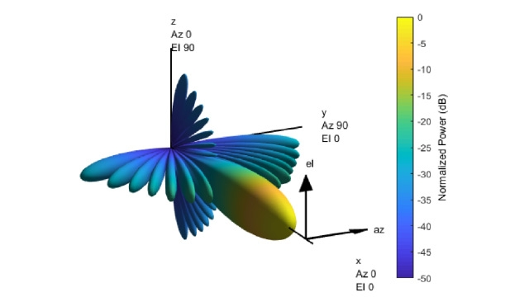
MATLAB Phased Array Toolbox
Powerful toolbox
Routines for:
Defining and visualizing arrays
Computing beam patterns
Beamforming
MIMO
Radar
…

Slide 12
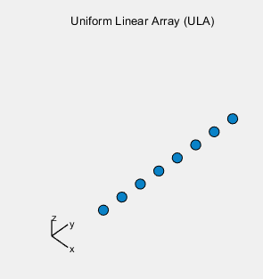
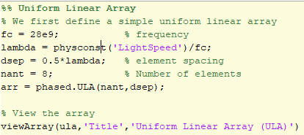
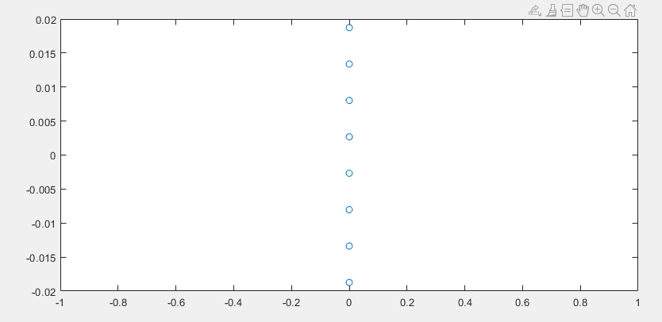
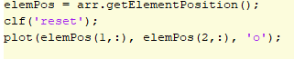
Example: Defining a ULA
Define and view the array
Can display array:
Using viewArray command
Or, manually

Slide 13
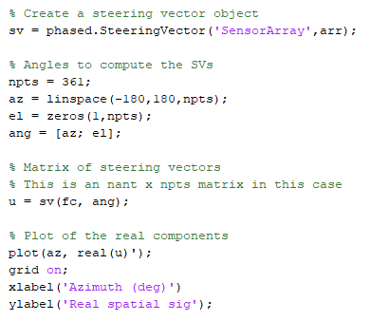
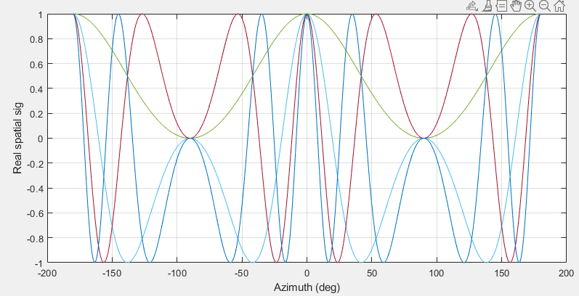
Computing the Spatial Signature
Compute the spatial signature with the SteeringVector object

Slide 14
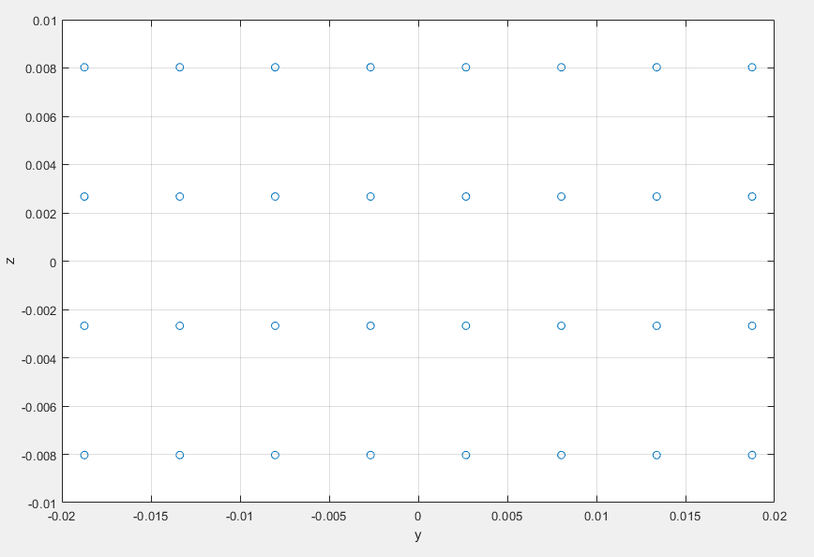
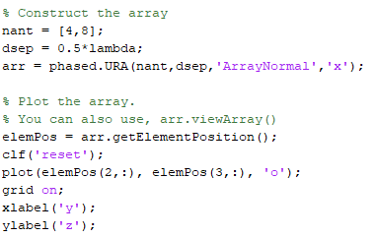
Example: Defining a URA
Define and view the array
Use the phased.URA class
Can compute steering vector similarly
A 4 x 8 URA with normal axis aligned on x

Slide 15
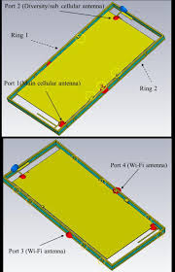
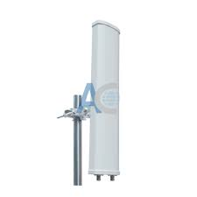
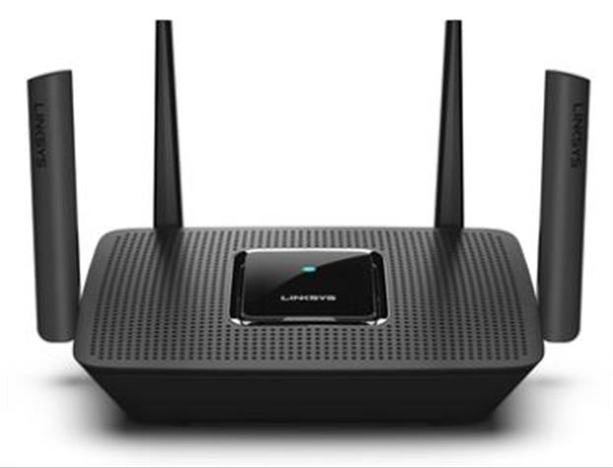
Multiple Antennas in Commercial Systems
Sub 6 GHz systems: Mostly 1 to 4 antennas on base stations or smart phones
Form factor restricts larger number of antennas
WiFi Router
Linksys AC2200 with 4TX/RX
2x2 LTE base station antenna
Cros-polarization
16 dBi element gain, 90 deg sector 750x120x60mm
K. Zhao, S. Zhang, K. Ishimiya, Z. Ying and S. He, "Body-Insensitive Multimode MIMO Terminal Antenna of Double-Ring Structure," in IEEE Transactions on Antennas and Propagation, vol. 63, no. 5, pp. 1925-1936, May 2015.

Slide 16
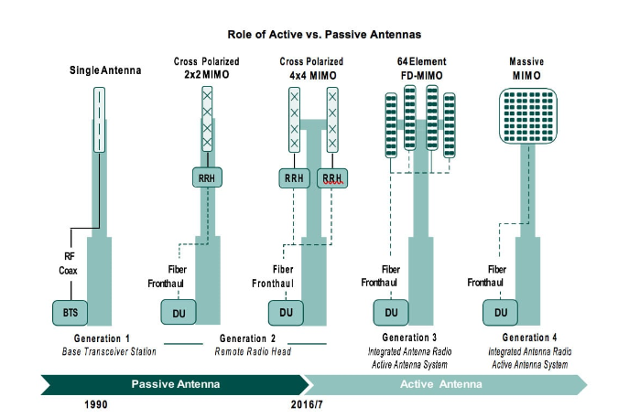
Massive MIMO
Massive MIMO:
Many base station antennas
64 to 128 in many systems today
Significant capacity increase
Typically 8x by most estimates
Use SDMA
Will discuss this later

Slide 17
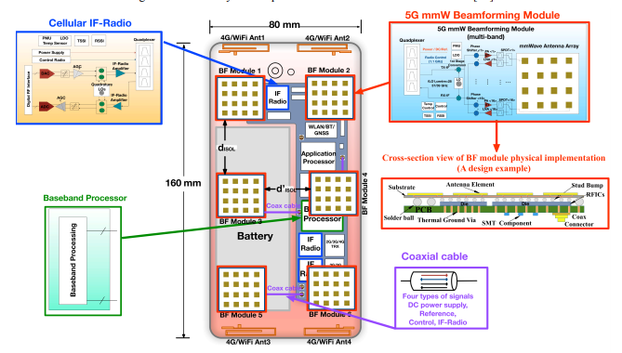
Beamforming and MmWave
To compensate for high isotropic path loss, mmWave systems need large number of antennas
5G handsets: Multiple arrays with 4 to 8 antennas each
5G base stations: 64 to 256 elements
IBM 28 GHz array
32 element dual polarized array Sadhu et al, ISSCC 2017
Huo, Yiming, et al. "Cellular and WiFi co-design for 5G user equipment." 2018 IEEE 5G World Forum (5GWF). IEEE, 2018.

Slide 18
Outline
Antenna Arrays and the Spatial Signature
Receive Beamforming and SNR Gain with a Single Path
Array Factor
Transmit Beamforming with a Single Path
Multipath and MIMO Channels
Linear Algebra and SVD Review
Beamforming Gains in Multipath Channels
Adding Element Gains and Normalizing Spatial Signatures for Mutual Coupling

Slide 19

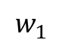
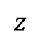
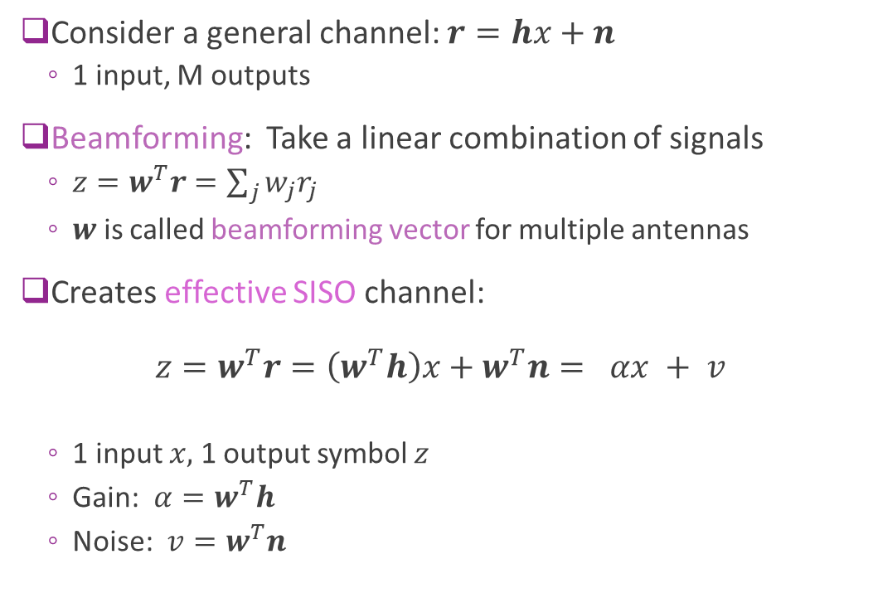
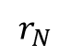
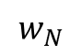
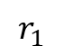
RX Beamforming
Consider a general channel: $r=hx+n$
1 input, M outputs
Beamforming: Take a linear combination of signals
$z=w^{T}r=\sum_{j}{w_{j}r_{j}}$
$w$ is called beamforming vector for multiple antennas
Creates effective SISO channel: $z=w^{T}r=\left(w^{T}h\right)x+w^{T}n= αx + v$
1 input $x,$ 1 output symbol $z$
Gain: $α=w^{T}h$
Noise: $v=w^{T}n$
$$w_{1}$$
$$r_{1}$$
X
+
$$⋮$$
$$z$$
$$w_{N}$$
$$r_{N}$$
X

Slide 20
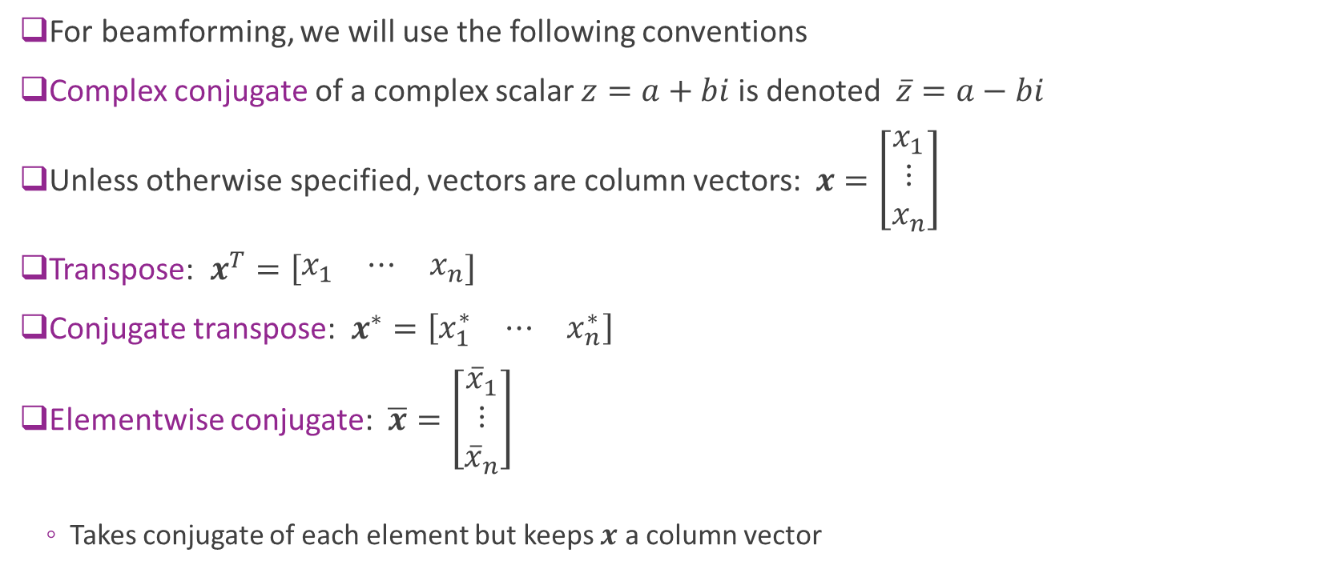
Conjugate Transpose Conventions
For beamforming, we will use the following conventions
Complex conjugate of a complex scalar $z=a+bi$ is denoted $\overline{z}=a−bi$
Unless otherwise specified, vectors are column vectors: $x=\left[\begin{matrix}x_{1} \\ ⋮ \\ x_{n}\end{matrix}\right]$
Transpose: $x^{T}=\left[\begin{matrix}x_{1} & ⋯ & x_{n}\end{matrix}\right]$
Conjugate transpose: $x^{∗}=\left[\begin{matrix}x_{1}^{∗} & ⋯ & x_{n}^{∗}\end{matrix}\right]$
Elementwise conjugate: $\overline{x}=\left[\begin{matrix}{\overline{x}}_{1} \\ ⋮ \\ {\overline{x}}_{n}\end{matrix}\right]$
Takes conjugate of each element but keeps $x$ a column vector

Slide 21
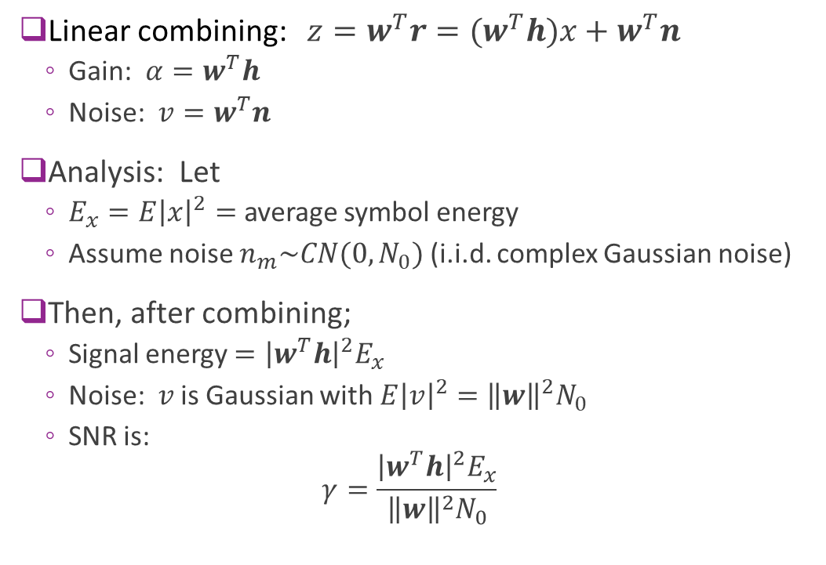
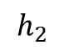
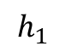
Beamforming Analysis
Linear combining: $z=w^{T}r=(w^{T}h)x+w^{T}n$
Gain: $α=w^{T}h$
Noise: $v=w^{T}n$
Analysis: Let
$E_{x}=E{\left|x\right|}^{2}=$ average symbol energy
Assume noise $n_{m}\sim CN(0,N_{0})$ (i.i.d. complex Gaussian noise)
Then, after combining;
Signal energy $={\left|w^{T}h\right|}^{2}E_{x}$
Noise: $v$ is Gaussian with $E{\left|v\right|}^{2}={\left\|w\right\|}^{2}N_{0}$
SNR is: $γ=\frac{{\left|w^{T}h\right|}^{2}E_{x}}{{\left\|w\right\|}^{2}N_{0}}$
$$h_{1}$$
$$h_{2}$$

Slide 22
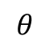
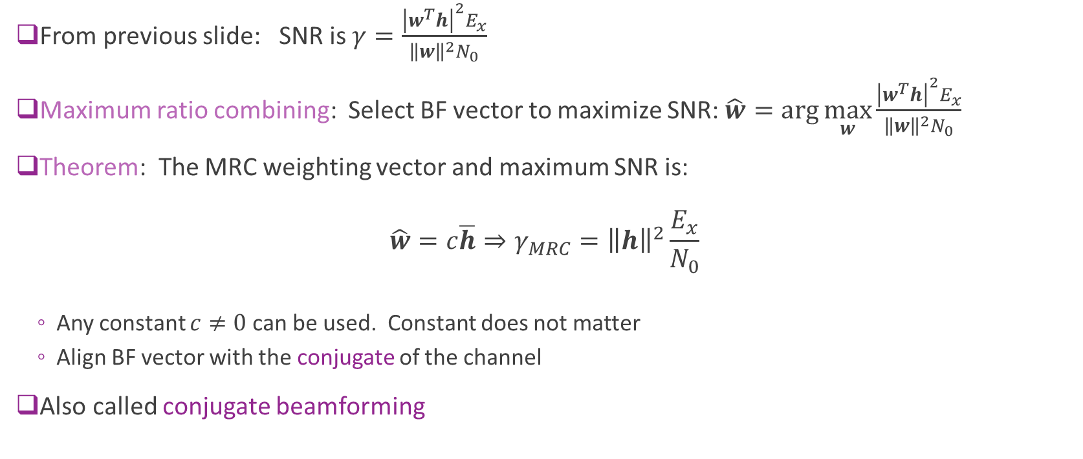
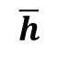

Maximum Ratio Combining
From previous slide: SNR is $γ=\frac{{\left|w^{T}h\right|}^{2}E_{x}}{{\left\|w\right\|}^{2}N_{0}}$
Maximum ratio combining: Select BF vector to maximize SNR: $\hat{w}=\arg{\max_{w}{\frac{{\left|w^{T}h\right|}^{2}E_{x}}{{\left\|w\right\|}^{2}N_{0}}}}$
Theorem: The MRC weighting vector and maximum SNR is: $\hat{w}=c\overline{h}⇒γ_{MRC}={\left\|h\right\|}^{2}\frac{E_{x}}{N_{0}}$
Any constant $c≠0$ can be used. Constant does not matter
Align BF vector with the conjugate of the channel
Also called conjugate beamforming
$$w$$
$$θ$$
$$\overline{h}$$

Slide 23
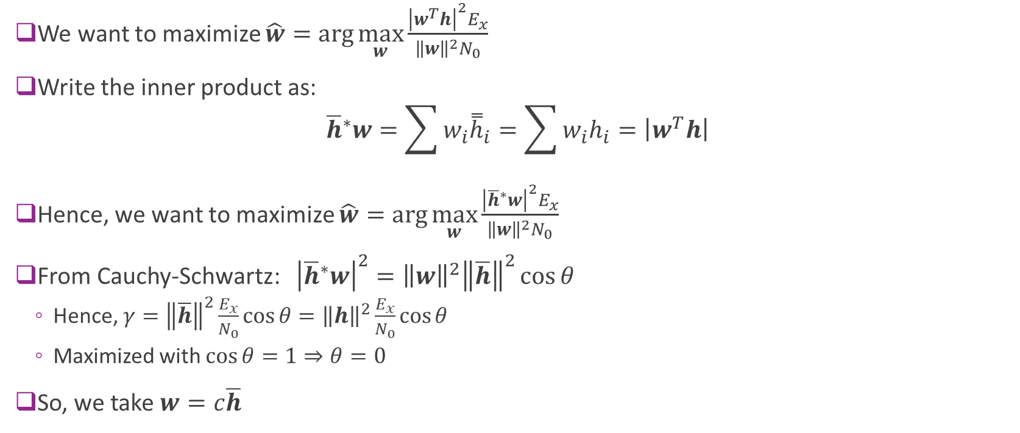
Proof of the MRC Solution
We want to maximize $\hat{w}=\arg{\max_{w}{\frac{{\left|w^{T}h\right|}^{2}E_{x}}{{\left\|w\right\|}^{2}N_{0}}}}$
Write the inner product as: ${\overline{h}}^{∗}w=\sum{w_{i}{\overset{̿}{h}}_{i}}=\sum{w_{i}h_{i}}=\left|w^{T}h\right|$
Hence, we want to maximize $\hat{w}=\arg{\max_{w}{\frac{{\left|{\overline{h}}^{∗}w\right|}^{2}E_{x}}{{\left\|w\right\|}^{2}N_{0}}}}$
From Cauchy-Schwartz: ${\left|{\overline{h}}^{∗}w\right|}^{2}={\left\|w\right\|}^{2}{\left\|\overline{h}\right\|}^{2}\cos{θ}$
Hence, $γ={\left\|\overline{h}\right\|}^{2}\frac{E_{x}}{N_{0}}\cos{θ}={\left\|h\right\|}^{2}\frac{E_{x}}{N_{0}}\cos{θ}$
Maximized with $\cos{θ}=1⇒θ=0$
So, we take $w=c\overline{h}$
Double conjugate
$$w$$
$$θ$$
$$\overline{h}$$

Slide 24

MRC Gain
SNR with MRC: $γ_{MRC}={\left\|h\right\|}^{2}\frac{E_{x}}{N_{0}}$
SNR on channel $i$ is: $γ_{i}=\frac{{\left|h_{i}\right|}^{2}E_{x}}{N_{0}}$
Average SNR is: $γ_{avg}=\frac{1}{M}\sum_{i=1}^{M}{γ_{i}}=\frac{1}{M}\sum_{i=1}^{M}{{\left|h_{i}\right|}^{2}}\frac{E_{x}}{N_{0}}=\frac{1}{M}{\left\|h\right\|}^{2}\frac{E_{x}}{N_{0}}$
MRC increases SNR by a factor of $M$ relative to average per channel SNR
Beamforming gain = $\frac{γ_{MRC}}{γ_{avg}}=M$
Example: Suppose average SNR per antenna is 10 dB.
With $M=16$ antennas and MRC, SNR $=10+10\log_{10}{(16)}=10+4\left(3\right)=22$ dB
Gain increases significantly!
Note: The gain assumes no mutual coupling.
Once antennas are close, the gain will no longer increase by $M$

Slide 25

Single Path Channel Case
Consider special case of single path channel: $r=g_{0}u\left(Ω\right)x+n$
Channel is $h=g_{0}u\left(Ω\right)$
SNR per antenna (before beamforming):
$γ_{0}=\frac{E_{x}{\left|g_{0}\right|}^{2}}{N_{0}}{\left|u_{m}(Ω)\right|}^{2}=\frac{E_{x}{\left|g_{0}\right|}^{2}}{N_{0}}$
Assume $u_{m}(Ω)$ includes only phase shifts
SNR after BF: $γ=\frac{{\left|w^{T}u\left(Ω\right)\right|}^{2}}{{\left\|w\right\|}^{2}}γ_{0}$
MRC beamforming: $\hat{w}=c\overline{u}\left(Ω\right)$ and $γ=$ ${\left\|u\left(Ω\right)\right\|}^{2}γ_{0}=Mγ_{0}$
Conclusions:
Optimal (MRC) beamforming vector is aligned to the conjugate of the spatial signature
Optimal SNR gain $=M$ (assuming no mutual coupling)
Linear gain with number of antennas

Slide 26



Example Problem
Consider a system
TX power = 23 dBm with antenna directivity = 10 dBi
Free space path loss$d=$ 1000 m
Sample rate = 400 Msym/s
Noise energy = -170 dBm/Hz (including NF)
RX antenna directivity = 5 dBi and 8 elements
Find SNR per antenna and SNR with MRC
Solution: We get a 9 dB gain!

Slide 27
In-Class Problem: Simple QPSK simulation
Simulate QPSK transmission over a single path channel

Slide 28
Outline
Antenna Arrays and the Spatial Signature
Receive Beamforming and SNR Gain with a Single Path
Array Factor
Transmit Beamforming with a Single Path
Multipath and MIMO Channels
Linear Algebra and SVD Review
Beamforming Gains in Multipath Channels
Adding Element Gains and Normalizing Spatial Signatures for Mutual Coupling

Slide 29



Array Factor
Suppose RX aligns antenna for AoA $Ω_{0}=(θ_{0},φ_{0})$
But signal arrives from AoA $Ω=(θ,φ)$
Define the (complex) array factor $AF\left(Ω,Ω_{0}\right)={\hat{w}}^{T}\left(Ω_{0}\right)u\left(Ω\right)=\frac{1}{\sqrt{M}}u^{∗}\left(Ω_{0}\right)u\left(Ω\right)$
Assume $\left\|\hat{w}\right\|=1$
Indicates directional gain as a function of AoA $θ$
Dependence on $θ_{0}$ often omitted
SNR gain = ${\left|AF\left(Ω,Ω_{0}\right)\right|}^{2}$
Max value = $M$
Usually measured in dBi (dB relative to isotropic)
Also called the array response
Actual arrival
$$Ω$$
BF direction
$$Ω_{0}$$
Array

Slide 30





Uniform Linear Array
$$y$$
Spatial signature (for azimuth angle $φ$):
$u\left(φ\right)={\left[1, e^{jβ},…,e^{i\left(M−1\right)β}\right]}^{T}, β=\frac{2πd\cos{φ}}{λ}$
Note change from $\sin{θ}$ to $\cos{φ}$. (Array aligned on y-axis)
Optimal BF vector for AoA $φ_{0}$
$\hat{w}\left(φ_{0}\right)=\frac{1}{\sqrt{M}}\overline{u}\left(φ_{0}\right)$ (Note normalization)
Array factor: $AF\left(φ,φ_{0}\right)=\frac{1}{\sqrt{M}}u^{∗}\left(φ_{0}\right)u\left(φ\right)=\frac{e^{j\left(M−1\right)γ/2}}{\sqrt{M}}\frac{sin({{Mγ}/{2)}}}{\sin{(γ/2)}},$
$γ=\frac{2πd}{λ}(\cos{φ}−\cos{φ_{0}})$,
Antenna gain: ${\left|AF\right|}^{2}=\frac{\sin^{2}({{Mγ}/{2)}}}{M\sin^{2}{(γ/2)}}$
Arrival
$$φ$$
BF direction
$$φ_{0}$$
$$x$$

Slide 31






Antenna Gain for ULA
$$d=λ/2, M=8$$
Broadside: $θ_{0}=0$
Endfire: $θ_{0}=90$
Maximum gain of
Note:
Endfire vs. broadside
Beamwidth $∝ 1/M$

Slide 32


Plotting the Array Factor
Create a SteeringVector object
Get steering vectors
Compute inner products

Slide 33


Polar Plot
Useful to visualize in polar plot
Note key features:
Direction of maximum gain
Sidelobes
Pattern repeated on reverse side

Slide 34

Key Statistics
Full null beamwidth (zero to zero)
Half power beamwidth (-3dB to -3dB)
First sidelobe level
From Jacobs University slides
Values in () for: $d=λ/2, M=8$

Slide 35



Grating Lobes
When $d>\frac{λ}{2}$
Obtain multiple peaks
Does not direct gain in one direction

Slide 36




Plotting the Patterns
MATLAB has excellent routines for 3D patterns
Note that this plots directivity not array factor

Slide 37
Outline
Antenna Arrays and the Spatial Signature
Receive Beamforming and SNR Gain with a Single Path
Array Factor
Transmit Beamforming with a Single Path
Multipath and MIMO Channels
Linear Algebra and SVD Review
Beamforming Gains in Multipath Channels
Adding Element Gains and Normalizing Spatial Signatures for Mutual Coupling

Slide 38


Multiple TX antennas
MISO channel
Multiple input single output
$M$ TX antennas, 1 RX antennas
Transmit vector: $x\left(t\right)={\left(x_{1}\left(t\right),…,x_{M}\left(t\right)\right)}^{T}$
Scalar RX: $r(t)$
Most of the theory is identical to the SIMO channel

Slide 39


Single Path Channel
First consider single path channel
Similar to the SIMO case, RX signal is: $r\left(t\right)=g_{0}A(Ω)u^{T}\left(Ω\right)x(t−τ)$
$g_{0}$ path gain
$Ω$= angle of departure
$τ$ = path delay
$u\left(Ω\right)$ TX spatial signature
$A(Ω)$: complex TX element gain
TX and RX spatial signatures are identical
$$Ω$$
TX array
RX with single antenna

Slide 40





TX Beamforming
RX signal is: $r\left(t\right)=g_{0}u^{T}\left(Ω\right)x\left(t−τ\right)+n(t)$
TX beamforming
Input scalar information signal $s\left(t\right)$
Create vector signal to antennas: $x\left(t\right)=w s\left(t\right)$
Signal to antenna $i$ is: $x_{i}\left(t\right)=w_{i}s(t)$
$w_{i}$ is a complex weight applied to signal
$w$ is called the TX beamforming vector
Also called pre-coding
$$w$$ TX BF vector
RX
TX array
$$Ω$$
$$s\left(t\right)$$
Scalar
$$x(t)$$
$N$ signals

Slide 41





SNR with TX Beamforming
RX signal is: $r=g_{0}u^{T}\left(Ω\right)x+n$
Drop dependence on time to simplify notation
With $x=ws$ SISO channel is $r=g_{0}u^{T}\left(Ω\right)ws+n$
Total transmitted energy across all $N$ TX chains is:
$E_{x}=\sum{{\left|w_{j}\right|}^{2}E_{s}}={\left\|w\right\|}^{2}E_{S}$
To keep constant total energy: ${\left\|w\right\|}^{2}=1$
Assumes no mutual coupling
SNR is $γ=\frac{{\left|g_{0}\right|}^{2}}{N_{0}}E_{s}{\left|u^{T}\left(Ω\right)w\right|}^{2}=γ_{0}{\left|u^{T}\left(Ω\right)w\right|}^{2}$
$γ_{0}=\frac{{\left|g_{0}\right|}^{2}}{N_{0}}E_{s}$ is the SNR for a single antenna
$$w$$ TX BF vector
RX
TX array
$$Ω$$
$$s\left(t\right)$$
Scalar
$$x(t)$$
$N$ signals

Slide 42





MRC TX Beamforming
From previous slide, SNR is: $γ=γ_{0}{\left|u^{∗}\left(Ω\right)w\right|}^{2}$
To maximize SNR s.t. power constraint $\hat{w}=arg max {\left|u^{T}\left(Ω\right)w\right|}^{2} s.t. {\left\|w\right\|}^{2}=1$
MRC TX BF vector: $\hat{w}=\frac{1}{\sqrt{N}}\overline{u}\left(Ω\right)$
Align with the conjugate of the spatial signature
SNR gain $={\left|u^{T}\left(Ω\right)\hat{w}\right|}^{2}=N$
Define and compute Array Factor similarly
$$w$$ TX BF vector
RX
TX array
$$Ω$$
$$s\left(t\right)$$
Scalar
$$x(t)$$
$N$ signals

Slide 43
Outline
Antenna Arrays and the Spatial Signature
Receive Beamforming and SNR Gain with a Single Path
Array Factor
Transmit Beamforming with a Single Path
Multipath and MIMO Channels
Linear Algebra and SVD Review
Beamforming Gains in Multipath Channels
Adding Element Gains and Normalizing Spatial Signatures for Mutual Coupling

Slide 44



MIMO Channel with a Single Path
Multi-input Multi-Output (MIMO) channel:
TX array with $N_{t}$ elements
RX array with $N_{r}$ elements
Single path channel: $r\left(t\right)=g_{0}u_{rx}\left(Ω^{rx}\right)u_{tx}^{T}\left(Ω^{tx}\right)x\left(t−τ\right)=Hx(t−τ)$
MIMO channel matrix for a single path channel: $H=g_{0}u_{rx}\left(Ω^{rx}\right)u_{tx}^{T}\left(Ω^{tx}\right)$
$$Ω^{tx}$$
RX array
$$Ω^{rx}$$
TX array

Slide 45

Beamforming on a MIMO Channel
Consider MIMO channel, $r=Hx+v$, $H∈ℂ^{M×N},$ $v\sim CN(0,N_{0}I)$
Channel on time and frequency resource
Apply TX beamforming: $x=w_{tx}s$
Assume $\left\|w_{tx}\right\|=1$ so total transmit energy is $E_{s}=E{\left|s\right|}^{2}$
Apply RX beamforming: $z=w_{rx}^{T}r$
Assume $\left\|w_{rx}\right\|=1$ so total received noise energy $E{\left|w_{rx}^{T}v\right|}^{2}=N_{0}$
Equivalent channel: $z=w_{rx}^{T}r=Gs+d,$
$G=w_{rx}^{T}Hw_{tx}=$ complex beamformed channel gain
Noise energy is $E{\left|w_{rx}^{T}v\right|}^{2}=N_{0}$
SNR with beamforming: $γ=\frac{{\left|G\right|}^{2}E_{s}}{N_{0}}=\frac{{\left|w_{rx}^{T}Hw_{tx}\right|}^{2}E_{s}}{N_{0}}$

Slide 46

Beamforming Gain with a Single Path
From previous slide, we saw SNR on a MIMO channel is: $γ=\frac{{\left|G\right|}^{2}E_{s}}{N_{0}}=\frac{{\left|w_{rx}^{T}Hw_{tx}\right|}^{2}E_{s}}{N_{0}}$
Suppose we have a single path channel: $H=g_{0}u_{rx}\left(Ω^{rx}\right)u_{tx}^{T}\left(Ω^{tx}\right)$
Take TX and RX conjugate beamforming vectors:
$w_{rx}=\frac{{\overline{u}}_{rx}\left(Ω^{rx}\right)}{\sqrt{N_{r}}},w_{tx}=\frac{{\overline{u}}_{tx}\left(Ω^{tx}\right)}{\sqrt{N_{t}}}$
Then SNR is $γ=\frac{{\left|g_{0}\right|}^{2}E_{s}}{N_{0}} \frac{{|u_{rx}^{∗}\left(Ω^{rx}\right)u}_{rx}\left(Ω^{rx}\right){\left.​\right|}^{2}}{N_{r}}\frac{{|u_{tx}^{∗}\left(Ω^{tx}\right)u}_{tx}\left(Ω^{tx}\right){\left.​\right|}^{2}}{N_{t}}=\frac{{\left|g_{0}\right|}^{2}E_{s}}{N_{0}}N_{r}N_{t}$
But $\frac{{\left|g_{0}\right|}^{2}E_{s}}{N_{0}}$ is the SNR per antenna
Conclusion: Maximum BF gain on a single path channel is $N_{r}N_{t}$
Again, assuming no mutual coupling

Slide 47


Friis’ Law and MmWave
Recall Friis’ Law: $\frac{P_{r}}{P_{t}}=D_{r}D_{t}{\left(\frac{λ}{4πR}\right)}^{2}$
Isotropic path loss decreases with $λ^{2}$
Millimeter Wave systems: Increases $f_{c}^{2}$
Decreases $λ^{2}⇒$ Increase path loss
But, with beamforming:
Directivity $D_{r}∝N_{r}$ and $D_{t}∝N_{t}$
Each antenna takes area $∝λ^{2}$
So, for fixed total aperture: $D_{r}∝N_{r}∝\frac{1}{λ^{2}}, D_{t}∝N_{t}∝\frac{1}{λ^{2}}$
Can compensate isotropic path loss with directivity

Slide 48


Friis’ Law and MmWave
Condition | Directivity scaling | Path loss scaling
No beamforming | $D_{i}$ constant | $PL∝f_{c}^{2}$
Beamforming on one side (TX or RX) | $D_{1}∝f_{c}^{2}, D_{2}$ constant | $PL$ constant
Beamforming on both sides (TX and RX) | $D_{1}, D_{2}∝f_{c}^{2}$ | $PL$ $∝f_{c}^{−2}$
Friis’ Law: $\frac{P_{r}}{P_{t}}=D_{1}D_{2}{\left(\frac{λ}{4πR}\right)}^{2}$
Conclusions: With a fixed aperture and beamforming
Isotropic path loss can be overcome
But systems need very directive beams
Raises many other issues. E.g. Channel tracking, processing, …

Slide 49


Multiple Paths
Easy to extend channel response to multiple paths
Each path adds a term with a spatial signature
Time-domain model $r\left(t\right)=\sum_{ℓ=1}^{L}{g_{ℓ}e^{jω_{ℓ}t}}u_{rx}\left(Ω_{ℓ}^{rx}\right)u_{tx}^{T}\left(Ω_{ℓ}^{tx}\right)x\left(t−τ_{ℓ}\right)+n(t)$
Doppler shift
AoA
AoD
Delay
Complex gain

Slide 50

Time-Varying Frequency Response
The channel response can also be described as a time and frequency-varying matrix
$$H\left(t,f\right)=\sum_{ℓ=1}^{L}{g_{ℓ}e^{2πj(f_{ℓ}t−τ_{ℓ}f)}}u_{rx}\left(Ω_{ℓ}^{rx}\right)u_{tx}^{T}\left(Ω_{ℓ}^{tx}\right)$$
At time and frequency $H\left(t,f\right)∈ℂ^{N_{r}×N_{t}}$
Varies in time due to Doppler shifts $f_{ℓ}$
Varies in frequency due to delay spread $τ_{ℓ}$

Slide 51



OFDM Time-Frequency Grid
Subcarrier spacing $F_{sc}=\frac{1}{T}$
Consider OFDM channel
Sub-carrier spacing $F_{sc}$, symbol time $T_{sym}$
Index with $k=$ OFDM symbol index, $n$ = subcarrier index
Transmit array: $X\left[n,k\right]$
At each $k,n$, we transmit a vector $X\left[n,k\right]={\left[X_{1}\left[n,k\right],…,X_{N}\left[n,k\right]\right]}^{T}$
$N=$number of TX antennas
Receive array: $Y\left[n,k\right]:$ $Y\left[n,k\right]={\left[Y_{1}\left[n,k\right], …, Y_{M}\left[n,k\right]\right]}^{T}$
$M=$ number of RX antennas
One $M$ dim vector per resource element
Frequency
OFDM symbol $T_{sym}$
Time

Slide 52

OFDM Channel with Multiple RX Antennas
OFDM channel acts as multiplication:
Under normal operation (delay spread is contained in CP): $Y\left[k,n\right]=H\left[k,n\right] X[k,n]$
OFDM channel gains can be computed from the multi-path components $H\left[k,n\right]=\sum_{ℓ=1}^{L}{g_{ℓ}e^{2πj \left(T_{sym}kf_{ℓ}−F_{sc}nτ_{ℓ}\right)}}u_{rx}\left(Ω_{ℓ}^{rx}\right)u_{tx}^{∗}(Ω_{ℓ}^{tx})$
$T=$ OFDM symbol time, $S=$ sub-carrier spacing
For each path: $f_{ℓ}=$Doppler shift, $τ_{ℓ}=$Delay, $g_{ℓ}=$complex gain
RX symbol vector
Channel matrix
TX symbol vector

Slide 53
Outline
Antenna Arrays and the Spatial Signature
Receive Beamforming and SNR Gain with a Single Path
Array Factor
Transmit Beamforming with a Single Path
Multipath and MIMO Channels
Linear Algebra and SVD Review
Beamforming Gains in Multipath Channels
Adding Element Gains and Normalizing Spatial Signatures for Mutual Coupling

Slide 54


Orthogonal Vectors
Let $𝔽=ℝ$ or $ℂ$ (real or complex)
Vectors $x,y∈𝔽^{N}$ are orthogonal if $\left\langle x,y\right\rangle =x^{∗}y=0$.
Write $x⊥y$
Visually, $x⊥y$ if they are at 90 degrees
A set of vectors $v_{1},…,v_{K}∈𝔽^{N}$are orthonormal
$v_{i}⊥v_{j}$ when $i≠j$
$\left\|v_{i}\right\|=1$ for all $i$
Vectors are pairwise orthogonal and unit norm
Orthonormal basis: An orthonormal set $v_{1},…,v_{N}∈𝔽^{N}$
Any vector can be written $x=∑α_{n}v_{n},$ $α_{n}=v_{n}^{∗}x$
$α_{n}$ are the coefficients of $x$ in the basis $v_{1},…,v_{N}$

Slide 55

Orthogonal and Unitary Matrices
A matrix $U∈ℂ^{N×N}$ is unitary if $U^{∗}U=UU^{∗}=I$
A matrix $U∈ℝ^{N×N}$ is orthogonal if $U^{T}U=UU^{T}=I$
Orthogonal is just the real-valued version of unitary
Key properties:
$U$ is orthogonal if and only if columns are orthonormal
$U$ is orthogonal if and only if rows are orthonormal
Taking an inverse is easy $U^{−1}=U^{∗}$

Slide 56

Examples of Orthogonal Matrices
2D rotation matrix by $θ$: $V=\left[\begin{matrix}\cos{θ} & \sin{θ} \\ −\sin{θ} & \cos{θ}\end{matrix}\right]$
Can verify that $V^{∗}V=I$
3D rotation matrices are also orthogonal
Example with 3 vectors:
Let $v_{1}=\frac{1}{\sqrt{11}}\left[\begin{matrix}3 \\ 1 \\ 1\end{matrix}\right], v_{2}=\frac{1}{\sqrt{6}}\left[\begin{matrix}−1 \\ 2 \\ 1\end{matrix}\right], v_{3}=\frac{1}{\sqrt{66}}\left[\begin{matrix}−1 \\ −4 \\ 7\end{matrix}\right]$
Can verify that $v_{i}^{∗}v_{j}=δ_{ij}$
Hence the matrix: $V=\left[\begin{matrix}3/\sqrt{11} & −1/\sqrt{6} & −1/\sqrt{66} \\ 1/\sqrt{11} & 2/\sqrt{6} & −4/\sqrt{66} \\ 1/\sqrt{11} & 1/\sqrt{6} & 7/\sqrt{66}\end{matrix}\right]$

Slide 57


Beamspace Matrices
Consider a ULA with normalized steering vector: $u\left(φ\right)=\frac{1}{\sqrt{N}}{\left[{1, e}^{jβ\cos{φ}}, …, e^{j\left(N−1\right)β\cos{φ}}\right]}^{T}, β=\frac{2πd}{λ}$
Take $N$angles: $β\cos{φ_{n}}=2π\left(\frac{n}{N}−\frac{1}{2}+\frac{1}{N}\right), n=0,1,…,N−1$
This is possible if $d≥\frac{λ}{2}$
The vectors $u\left(φ_{n}\right), n=0,1,…,N−1$ are orthonormal
These are called the beamspace vectors
An orthonormal basis for the spatial domain

Slide 58

Symmetric and Hermitian Matrices
Definition:
A matrix $A∈ℝ^{N×N}$ is symmetric if $A=A^{T}$
A matrix $A∈ℂ^{N×N}$ is Hermitian if $A=A^{∗}$
Symmetric is the real version of Hermitian
For any $A$ symmetric / Hermitian:
There are an orthonormal set of eigenvectors $v_{1},..,v_{N}$ with eigenvalues $λ_{1},…,λ_{N}$
All eigenvalues are real (not complex)
Let $V=\left[v_{1},…,v_{N}\right]∈𝔽^{N×N}$ = Matrix with the eigenvectors as the columns
Then $V=V^{∗}$ is orthogonal / unitary
Hence $A=VDV^{∗}, D=diag(λ_{1},…,λ_{N})$ diagonalizable with unitary

Slide 59

Sample Problem
Let $A=\left[\begin{matrix}1 & 2 \\ 2 & 1\end{matrix}\right]$. Find an orthogonal bases of eigenvectors and their eigenvalues
Solution: Eigenvalues:
$\det\left(λI−A\right)=det\left[\begin{matrix}λ−1 & −2 \\ −2 & λ−1\end{matrix}\right]={\left(λ−1\right)}^{2}−4=0$
$λ=1±2=−1,3$
For $λ=−1,\left(λI−A\right)v=\left[\begin{matrix}−2 & −2 \\ −2 & −2\end{matrix}\right]\left[\begin{matrix}v_{1} \\ v_{2}\end{matrix}\right]=\left[\begin{matrix}0 \\ 0\end{matrix}\right]⇒v_{1}=−v_{2}$
Take $v=\frac{1}{\sqrt{2}}{\left[1,−1\right]}^{T}$
For $λ=3,\left(λI−A\right)v=\left[\begin{matrix}2 & −2 \\ −2 & 2\end{matrix}\right]\left[\begin{matrix}v_{1} \\ v_{2}\end{matrix}\right]=\left[\begin{matrix}0 \\ 0\end{matrix}\right]⇒v_{1}=v_{2}$
Take $v=\frac{1}{\sqrt{2}}{\left[1,1\right]}^{T}$

Slide 60

Positive Definite Matrices
Let $A=A^{∗}∈𝔽^{N×N}$ be symmetric / Hermitian with eigenvalues $λ_{1},…,λ_{N}$
Recall that the eigenvalues are real
Definition:
$A$ is positive semi-definite if $λ_{i}≥0$ for all $i$
$A$ is positive definite if $λ_{i}>0$ for all $i$
Notation: $A>0$ for positive definite and $A≥0$ when $A$ is positive semi-definite
Key property: If $A=A^{∗}$ then:
$A≥0$ if and only if $x^{∗}Ax≥0$ for all $x$
$A>0$ if and only if $x^{∗}Ax>0$ for all $x≠0$

Slide 61





Matrix Square Roots
Theorem: Let $A∈𝔽^{N×N}.$ Then $A≥0$if and only if $A=BB^{∗}$ for some $B∈𝔽^{N×M}$
Note: The dimension $M$ can be anything $(M≥N$ or $M<N)$
Proof:
$(⇒)$ Suppose $A≥0$. Then $A=UDU^{∗}, D=diag(λ_{1},…,λ_{N})$
Write $B=UD^{1/2}U^{∗}$. $D=diag(λ_{1}^{1/2},…,λ_{N}^{1/2})$
Then: $BB^{∗}=B^{2}=UD^{1/2}U^{∗}$ $UD^{1/2}U^{∗}=UDU^{∗}=A$
Since $A=B^{2}$ and $B≥0$, $B$ is called the matrix square root. Write $B=A^{1/2}$
$(⇐)$ Suppose $A=BB^{∗}$.
Then for any $x,$ $x^{∗}Ax=x^{∗}BB^{∗}x={\left\|B^{∗}x\right\|}^{2}≥0$
$$A$$
$$B$$
$$B^{∗}$$
$$=$$

Slide 62





















Singular Value Decomposition
“Tall” $A$, $M≥N$
“Fat” $A$, $M≤N$
$$A$$
$$U$$
$$V^{∗}$$
$$A$$
$$=$$
$$U$$
$$Σ$$
$$=$$
$$Σ$$
$$V^{∗}$$
$$N×N$$
$$M×N$$
$$M×M$$
$$M×N$$
$$M×N$$
$$M×M$$
$$M×N$$
$$N×N$$
Given matrix $A∈𝔽^{M×N}$, an SVD is a factorization of the form, $A=UΣV^{T}$ where
$U∈𝔽^{M×M}, U^{∗}U=I_{M}$, a unitary matrix
$V∈𝔽^{N×N}, V^{∗}V=I_{N}$, a unitary matrix
If $M≥N$, $Σ=\left[\begin{matrix}\text{d}\text{iag}(σ_{1},…,σ_{N}) \\ 0_{\left(M−N\right)×N}\end{matrix}\right]$ . If $N≥M$, $Σ=\left[\begin{matrix}\text{d}\text{iag}(σ_{1},…,σ_{M}) & 0_{N×(M−N)}\end{matrix}\right]$
Values $σ_{1}≥σ_{2}≥⋯≥σ_{L}≥0, L=min\left(M,N\right).$ Called the singular values
All matrices have an SVD
Notes:
SVD is a powerful techniuque in all kinds of numerical linear algebra/ml/etc.
It's just a way to compute principal component analysis
SVD is kind of like an eigenvalue decomposition that it factors the matrix into three parts.
S is diagonal, rxr, sorted called singular values.
All marix in universe has svd. Even if not square.

Slide 63





Example
Let $A=$
Then can check that $A=UΣV^{∗}$
Also verify that $UU^{∗}=I_{5}$ and $VV^{∗}=I_{5}$
This can be found by (cleverly) permute the rows of $A$
But, in general, use a computer to compute SVD

Slide 64




Geometric Interpretation
Let $A=UΣV^{∗}$ and $y=Ax$
Consider a transformed space
$w=V^{∗}x$ so $w=[w_{1},…,w_{N}]$ are the coefficients of the input in the basis $V=[v_{1},…,v_{N}]$
$z=U^{∗}y$ so $z=[z_{1},…,z_{M}]$ are the coefficients in the basis $U=[u_{1},…,u_{M}]$
Then: $z=Σw$ so $z_{i}=σ_{i}w_{i}$
Each input direction $v_{i}$ is mapped to $σ_{i}u_{i}$
Consequence:
SVD finds orthonormal bases $U,V$ such that matrix $A$ is a linear scaling in each basis vector
$$x$$
$$y$$
_{A}
_{A}

Slide 65



SVD and Rank
Theorem: Suppose $A=UΣV^{∗}∈𝔽^{M×N}$, then $rank\left(A\right)=\left|\left\{σ_{ℓ}>0\right\}\right|=$ num of positive singular values
Ex: Suppose $A∈ℂ^{5×3}$with $σ=\{10,2,0\}$
Then: $rank\left(A\right)=2$
Proof:
For any $x,$ the output is $y=Ax=UΣV^{∗}x$
Define $z=U^{∗}y$ and $w=V^{∗}x$
Then $z_{ℓ}=σ_{ℓ}w_{ℓ}$
If $r=\left|\left\{σ_{ℓ}>0\right\}\right|,$ then $σ_{ℓ}>0$ for $ℓ=1,…,r$
Hence, by varying $w_{ℓ}$, we can span a space of dimension $r$
$$x$$
$$y$$
_{A}
_{A}
65

Slide 66






Sum of Rank One Form
Suppose $A=UΣV^{∗}∈𝔽^{M×N}$ with $r=rank(A)$
Then: $A=\sum_{ℓ=1}^{r}{σ_{ℓ}u_{ℓ}v_{ℓ}^{∗}}$
A sum of rank one terms $u_{ℓ}v_{ℓ}^{∗}$
The vectors $u_{ℓ}, ℓ=1,…,r$ are an orthonormal basis for $Range(A)$
The vectors $v_{ℓ}, ℓ=1,…,r$ are an orthonormal basis for $Range(A^{∗})$
$$A$$
$$U$$
$$V^{∗}$$
$$=$$
$$Σ$$

Slide 67
Outline
Antenna Arrays and the Spatial Signature
Receive Beamforming and SNR Gain with a Single Path
Array Factor
Transmit Beamforming with a Single Path
Multipath and MIMO Channels
Linear Algebra and SVD Review
Beamforming Gains in Multipath Channels
Adding Element Gains and Normalizing Spatial Signatures for Mutual Coupling

Slide 68

SVD of the Channel Matrix
Consider a MIMO channel matrix: $H=\sum_{ℓ=1}^{L}{\sqrt{E_{ℓ}}e^{θ_{ℓ}}}u_{rx}\left(Ω_{ℓ}^{rx}\right)u_{tx}^{T}\left(Ω_{ℓ}^{tx}\right)$
$E_{ℓ}=$ RX energy per antenna on path $ℓ$
$θ_{ℓ}=$ phase that varies with frequency and time
We can write this as: $H=\sum_{ℓ=1}^{L}{σ_{ℓ}}{\hat{u}}_{ℓ}{\hat{v}}_{ℓ}^{∗}$ where
${\hat{u}}_{ℓ}=\frac{1}{\sqrt{N_{rx}}}e^{θ_{ℓ}}u_{rx}\left(Ω_{ℓ}^{rx}\right)$ and ${\hat{v}}_{ℓ}=\frac{1}{\sqrt{N_{tx}}}{\overline{u}}_{tx}\left(Ω_{ℓ}^{tx}\right)$= normalized steering vectors
$σ_{ℓ}=\sqrt{E_{ℓ}N_{rx}N_{tx}}$
Interpretation:
$L=$number of paths = rank of $H$
If the signatures ${\hat{u}}_{ℓ}$ and ${\hat{v}}_{ℓ}$ are orthogonal then they are the left and right singular vectors
In this case, singular values squared $σ_{ℓ}^{2}=E_{ℓ}N_{rx}N_{tx}=$RX energy $×$ beamforming gain

Slide 69
Beamforming on a MIMO Channel
Consider MIMO channel, $r=Hx+v$, $H∈ℂ^{M×N},$ $v\sim CN(0,N_{0}I)$
Channel on time and frequency resource
Apply TX beamforming: $x=w_{tx}s$
Assume $\left\|w_{tx}\right\|=1$ so total transmit energy is $E_{s}=E{\left|s\right|}^{2}$
Apply RX beamforming: $z=w_{rx}^{T}r$
Assume $\left\|w_{rx}\right\|=1$ so total received noise energy $E{\left|w_{rx}^{T}v\right|}^{2}=N_{0}$
Equivalent channel: $z=w_{rx}^{T}r=Gs+d,$
$G=w_{rx}^{T}Hw_{tx}=$ complex beamformed channel gain
Noise energy is $E{\left|w_{rx}^{T}v\right|}^{2}=N_{0}$
SNR with beamforming: $γ=\frac{{\left|G\right|}^{2}E_{s}}{N_{0}}=\frac{{\left|w_{rx}^{T}Hw_{tx}\right|}^{2}E_{s}}{N_{0}}$

Slide 70

Maximizing the SNR
From previous slide, MIMO channel with beamforming is $z=Gs+d,$
Gain: $G=w_{rx}^{T}Hw_{tx}$
Noise energy $E{\left|d\right|}^{2}=N_{0}$
SNR: $γ=\frac{{\left|G\right|}^{2}E_{s}}{N_{0}}=\frac{{\left|w_{rx}^{∗}Hw_{tx}\right|}^{2}E_{s}}{N_{0}}$
Want to select the beamforming vectors to maximize the SNR: $\max_{w_{rx}, w_{tx}} {\left|w_{rx}^{T}Hw_{tx}\right|}^{2} s.t.\left\|w_{tx}\right\|=\left\|w_{rx}\right\|=1$
Theorem: Let $H=UΣV^{∗}$ be the SVD. Then, then the optimal vectors are
$w_{rx}={\overline{u}}_{1}=$ conjugate of the left singular vector for maximal singular value
$w_{tx}={\overline{v}}_{1}=$ conjugate of the right singular vector for maximal singular value
Also, the max value is $σ_{1}^{2}=$ maximum singular value squared

Slide 71

CSI Requirements
Optimal BF vectors are maximal singular vectors of channel matrix $H$
Problem: TX and RX must know $H$ exactly
Channel state information (CSI) must be available at TX and RX
In general, $H$ varies with time and frequency
Hence channel needs to be tracked!
Next lecture we will discuss:
How to track channel in practical systems
Methods to approximate beamforming if exact tracking is not possible

Slide 72
Outline
Antenna Arrays and the Spatial Signature
Receive Beamforming and SNR Gain with a Single Path
Array Factor
Transmit Beamforming with a Single Path
Multipath and MIMO Channels
Linear Algebra and SVD Review
Beamforming Gains in Multipath Channels
Adding Element Gains and Normalizing Spatial Signatures for Mutual Coupling

Slide 73

Modeling the Element Pattern
Above analysis assumes each element is omni-directional
However, in most systems, each antenna element may also have gain.
In this section, we describe two methods to account for element gain
Method 1. Pattern multiplication without normalization
Provides a simple approximation of the channel response
But neglects mutual coupling
Method 2. Pattern multiplication with normalization
More accurate
Partially accounts for mutual coupling
SiBeam 60 GHz array
12 TX and 12 RX elements.

Slide 74





Uncoupled Array Assumption
Consider a TX array with $N$elements in free space
Analysis for RX is similar
In isolation, we know each TX signal $s_{n}$ will produce an RX signal $r=g_{0}s_{n}u_{n}\left(Ω\right)A_{E}(Ω)$
$g_{0}=$ free space path gain from a reference location
$u_{n}\left(Ω\right)=$ phase shift due to the element location relative to reference
$A_{E}\left(Ω\right)=$ complex element gain (assumed common for all elements)
Uncoupled array assumption:
The response from the $N$ antennas together is given by super-position $$r=\sum_{n=1}^{N}{g_{0}s_{n}u_{n}\left(Ω\right)A_{E}(Ω)}=g_{0}A_{E}\left(Ω\right)s^{T}u\left(Ω\right)$$
This is the assumption we have made implicitly up to now
RX $r$
TX array
$$d$$
$$s$$
$$Ω$$

Slide 75

Pattern Multiplication
Previous slide shows that ignoring mutual coupling, the TX channel response is:
$$h≈g_{0}v_{0}^{T}\left(Ω\right), v_{0}\left(Ω\right)=A_{E}\left(Ω\right)u(Ω)$$
We call $v\left(Ω\right)$ the pattern multiplication signature or un-normalized spatial signature
Multiplication of the array spatial signature with the element pattern
Key properties:
TX channel is $h=g_{0}v\left(Ω\right)$
Optimal BF vector $w\left(Ω\right)=\frac{1}{\left\|v_{0}\left(Ω\right)\right\|}{\overline{v}}_{0}\left(Ω\right)=\frac{1}{\sqrt{M}}\overline{u}\left(Ω\right)$
Optimal BF gain |$w{\left(Ω\right)}^{T}v_{0}\left(Ω\right){\left.​\right|}^{2}={\left|A_{E}\left(Ω\right)\right|}^{2}M=$peak element gain $×$ peak array gain
Array factor is $AF\left(Ω, Ω_{0}\right)={\left|w{\left(Ω_{0}\right)}^{T}v_{0}\left(Ω\right)\right|}^{2}=\frac{1}{M}{\left|A_{E}\left(Ω\right)\right|}^{2}{\left|u^{∗}\left(Ω_{0}\right)u\left(Ω\right)\right|}^{2}$

Slide 76









Impedance and Resistance Matrices
To model mutual coupling, we need some simple network theory
The input to an array can be modeled as an $N$port network
Each “port” has an input current $I_{n}$ and voltage $V_{n}$
Physically, the port would be the antenna feed
The currents and voltages are represented in complex baseband
Any $N$ port network is characterized by an $N×N$ impedance matrix $Z$ $V=ZI$
$I$ and $V$ are the vector of currents and voltages
The impedance matrix accounts for coupling between ports
The real power consumed in the network is $P=\frac{1}{2}Real\left(I^{∗}V\right)=\frac{1}{2}Real\left(I^{∗}ZI\right)=\frac{1}{2}I^{∗}RI$
$R=\frac{1}{2}\left(Z+Z^{∗}\right)=$Hermitian part of $Z$. Called the resistance matrix
$$I_{1}$$
$$+$$
$$V_{1}$$
$$−$$
Coupling
$$I_{N}$$
$$+$$
$$V_{N}$$
$$−$$

Slide 77





Normalized Steering Vector
To account for coupling between antennas, define the normalized spatial signature $v\left(Ω\right)=Q^{{−1}/2}A_{E}\left(Ω\right)u\left(Ω\right), Q=\int_{−π}^{π}{\int_{−π/2}^{π/2}{{\left|A_{E}\left(Ω\right)\right|}^{2} u\left(Ω\right)u^{∗}\left(Ω\right)\cos{θ}dθdφ}}$
$v\left(Ω\right)$ is a scaled version of the spatial signature with pattern multiplication $v_{0}\left(Ω\right)$
$Q$ is called the normalization matrix, $Q^{{−1}/2}=$ inverse of the matrix square root
Theorem: The TX channel in free space is$h=g_{0}v^{T}\left(Ω\right)$
Recall, $g_{0}$ is the free space channel from the reference point in the array
Proved below using network theory
Conclusion: $v\left(Ω\right)$ represents the array response
Properly accounts for coupling between elements
RX
$$r$$
$$g_{0}$$
TX array
$$s$$
$$Ω$$

Slide 78






Normalized Channel Response
Theorem: There exists a constant $C>0$ such that if $s= \sqrt{C}{\overline{Q}}^{1/2}I$:
The total transmitted power is ${\left\|s\right\|}^{2}$
The received signal at a point in free space is $r=g_{0}v^{T}\left(Ω\right)s$ where $g_{0}$is the free space SISO channel
Received power is ${\left|r\right|}^{2}={\left|g_{0}\right|}^{2}{\left|v^{T}\left(Ω\right)s\right|}^{2}$
Proof: Will be done in several slides below
Conclusion: $v\left(Ω\right)$ represents the effective array response
Properly accounts for coupling between elements
Based on a transformation of the signals to array
RX
$$r$$
$$g_{0}$$
TX array
$$I$$
$$Ω$$
$$s$$

Slide 79

Numerical Procedure for Normalization
Get angles $Ω_{k}=\left(θ_{k},φ_{k}\right),k=1,…,K$ uniformly in $θ_{k}∈\left[−\frac{π}{2},\frac{π}{2}\right], φ_{k}∈\left[−π,π\right]$
Get steering vectors $u\left(Ω_{k}\right)$ and element gain $A_{E}(Ω_{k})$ at each angle
Compute normalization matrix: $Q=\frac{1}{cK}\sum_{k=1}^{K}{\cos{θ_{k}}} {\left|A_{E}\left(Ω_{k}\right)\right|}^{2}u\left(Ω_{k}\right)u^{∗}\left(Ω_{k}\right), c=\frac{1}{K}\sum_{k=1}^{K}{\cos{θ_{k}}}$
Scale factor $c$ used to normalize the summation
The normalized steering vector at any new angle $Ω$ is $v\left(Ω\right)=A_{E}(Ω)Q^{−1/2}u(Ω)$
The complex gain with beamforming vector $w$ is $w^{T}v\left(Ω\right)$
Power gain $G={\left|w^{T}v\left(Ω\right)\right|}^{2}$

Slide 80



Array Element Example
Element:
Patch Microstrip
Max gain 10 dBi gain
Array: 4x4 URA
Max gain = $10\log_{10}{16}=12$dBi
Has directivity in back and front

Slide 81



Array Factor Examples
For each target angle:
Find optimal BF vector
Compute resulting array factor
Array factor computed for
No normalization (approximate)
Normalization
We see approximation is close
But overestimates peak gain
No normalization
Normalization
Target angle
$$\left(θ,φ\right)=(0,0)$$
$$\left(θ,φ\right)=(30,45)$$

Slide 82


Max Gain
Plotted:
Max gain in each angle
With no normalization:
Max gain at boresight$=12+10.1=22.1$ dBi
With normalization:
Max gain at boresight$=$18.3 dBi
Max gain at other angles more uniform

Slide 83





Proof Part 1: Analyzing in Current Domain
Let $I={\left[I_{1},…,I_{N}\right]}^{T}=$ vector of complex baseband current inputs to the antennas
Consider electric field at angle $Ω=(φ,θ)$ at far distance $d$
Assume the electric field from a single current $I_{n}$ is: $E(Ω)=\frac{c}{d}A_{E}\left(Ω\right)u_{n}(Ω)I_{n}$
$c=$ some proportionality constant
We know super-position applies for currents
This is a consequence of Maxwell’s equations
Hence with all $N$ currents: $E\left(Ω\right)=\frac{c}{d}A_{E}\left(Ω\right)\sum_{n=1}^{N}{u_{n}\left(Ω\right)I_{n}}=\frac{c}{d}A_{E}\left(Ω\right)u{\left(Ω\right)}^{T}I$
$$I_{n}$$
$$+$$
$$V_{n}$$
$$−$$
TX antenna $n$

Slide 84





Proof Part 2: Total Radiated Power
RX
From previous slide: Electric field is $E(Ω)=\frac{c}{d}A_{E}\left(Ω\right)u^{T}\left(Ω\right)I$
Hence, power intensity is $U\left(Ω\right)=\frac{d^{2}}{2η}{\left|E\left(Ω\right)\right|}^{2}=C{\left|A_{E}\left(Ω\right)u^{T}\left(Ω\right)I\right|}^{2}$
$C=\frac{{\left|c\right|}^{2}}{2η}, η=$characteristic impedance
Hence, the total radiated power is: $P_{tx}=∫U\left(Ω\right)dΩ=\int_{−π}^{π}{\int_{−π/2}^{π/2}{U\left(φ,θ\right)\cos{θ}dθdφ}}=CI^{∗}\overline{Q}I$
Here $Q=\int_{−π}^{π}{\int_{−π/2}^{π/2}{{\left|A_{E}\left(Ω\right)\right|}^{2} u\left(Ω\right)u^{∗}\left(Ω\right)\cos{θ}dθdφ}}$
$\overline{Q}=$elementwise complex conjugate of $Q$
$$E(Ω)$$
TX array
$$d$$
$$I$$
$$Ω$$

Slide 85









Proof Part 3: Array Resistance Matrix
From previous slide we saw that : $P_{tx}=CI^{∗}\overline{Q}I$
$\overline{Q}$ can be computed from the integral of spatial signatures
We know from network theory the power consumed is $\frac{1}{2}I^{∗}RI$
$R$= resistance matrix of the array
If the antennas are lossless, this power must be transmitted
Hence $P_{tx}=\frac{1}{2}I^{∗}RI$
Conclusions:
The matrix $\overline{Q}$ is a scaled version of the antenna array resistance matrix
The matrix captures the coupling of currents and voltages between antennas
$$I_{1}$$
$$+$$
$$V_{1}$$
$$−$$
Coupling
$$I_{N}$$
$$+$$
$$V_{N}$$
$$−$$

Slide 86

Proof Part 4: Computing the Channel
Up to now we have shown:
Total transmitted power is $P_{tx}=CI^{∗}\overline{Q}I$
Radiation intensity at angle $Ω$ is $U\left(Ω\right)=C{\left|A_{E}\left(Ω\right)u^{T}\left(Ω\right)I\right|}^{2}$
Define:
Power input vector: $s= \sqrt{C}{\overline{Q}}^{1/2}I$
Normalized steering vector: $v\left(Ω\right)=A_{E}(Ω)Q^{−1/2}u(Ω)$
With these definitions:
Total transmitted power is $P_{tx}=CI^{∗}QI={\left\|s\right\|}^{2}$
Radiation intensity at angle $Ω$ is $U\left(Ω\right)=C{\left|A_{E}\left(Ω\right)u^{T}\left(Ω\right)I\right|}^{2}={\left|v^{T}\left(Ω\right)s\right|}^{2}$
Hence ${\left|v^{T}\left(Ω\right)s\right|}^{2}$ is the power gain relative to free space propagation
Therefore, channel can be modeled as $g_{0}v^{T}\left(Ω\right)s$ is the free space channel

